Slide 1

CLEARCARE DATA INITIATIVE
TEAM 4 (MIS 6349.001)
NITHISH YERRAM - NXY220009
UTKARSHA C. - UXC220003
SAI THUSHARA C. - SXC220023
KRATI SHAH - KXS220081
SVAYAM PRABHA - SXS230003
PRANAV NAYAK - PXN220028

Slide 2
INTRODUCTION
Improving hospital price transparency.
OBJECTIVE
Hospitals to publicly display pricing and billing details.
PRICE TRANSPARENCY LAW
Problem: Hidden costs and unclear pricing
Solution: Informed decisions by revealing cost variations between insurance providers.
WHY?

Slide 3


PROJECT SCOPE
Challenges, and Key Decisions
Business Objectives and Challenges
Problem Statement Clarity
Domain and scope understanding
Align client goals with academic objectives
Client and Professor Meetings
Discussions with medical and insurance professionals
Review hospital transparency laws and guidelines
Decisions
Dataset Exploration and Prioritization
Focused on impactful data (CPT codes)
Defined tasks and clarified scope early.
Insurance Pricing Analysis
Reviewed hospital and insurance pricing.
Selected data fields that align with business objectives.

Slide 4
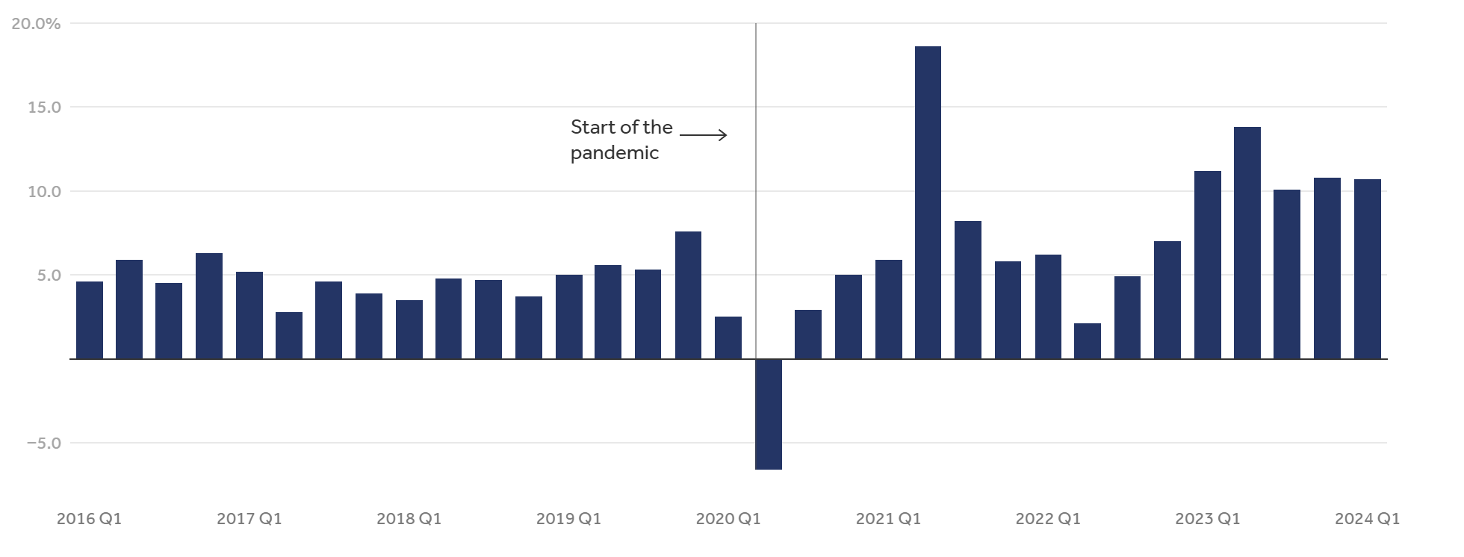
YEAR-OVER-YEAR GROWTH IN HEALTH SERVICES SPENDING
[2016 Q1 - 2024 Q1]

Slide 5
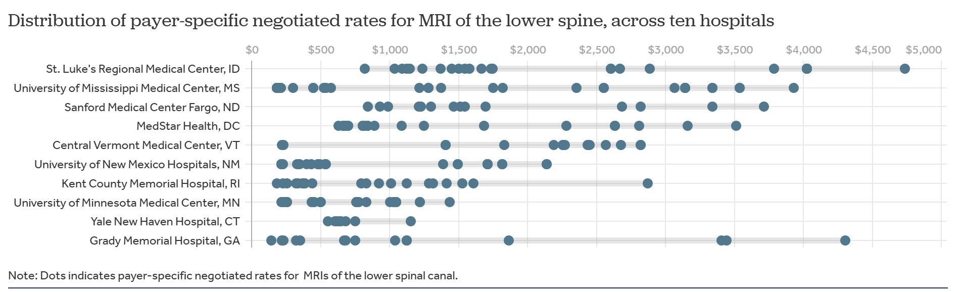
CHARGES
Source: healthsystemtracker.org

Slide 6

HOSPITAL DATA AUDIT
“46% of the 5879 hospitals that were required to comply with the HPT rule did not comply with the requirements to make information on their standard charges available to the public.”
Source: oig.hhs.gov

Slide 7
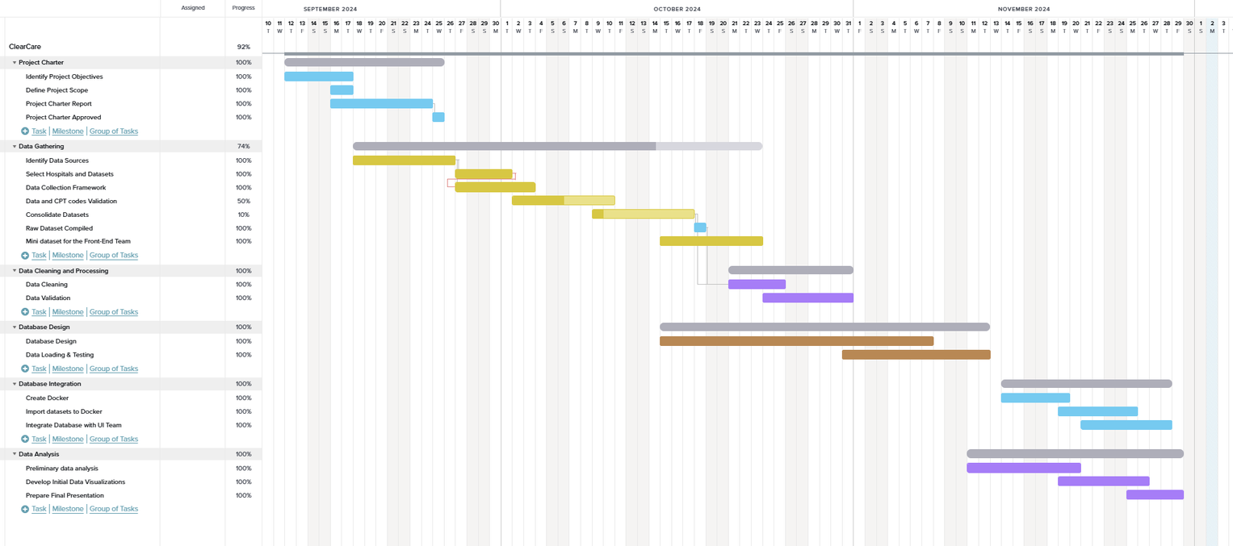
PROJECT TIMELINE
Project Charter
Data Gathering and Validation
Database and Integration
Defined project objectives and scope and created reports to align with stakeholders
Identified data sources for collection.
Consolidated datasets and created mini datasets for the front-end team.
Focused on data cleaning, validation, and processing.
Developed initial data visualizations and performed preliminary analysis.
Created Docker containers and finalized the database setup.
SEP
OCT
NOV

Slide 8
CHALLENGES
SOLUTIONS
LEARNINGS
Notes:
Every project comes with its own set of challenges. What matters is how we address hurdles, the strategies we employed, and the insights we gained along the way.

Slide 9

DATA SOURCING
CHALLENGES
SOLUTIONS
HIPAA-CPT Codes & Descriptions
Lack of Domain expertise
Paywall Issue
Federal websites, Reddit, ChatGPT
Healthcare domain expert consultations
Communication with hospitals
Reduced Scope
LEARNINGS
Acquiring domain knowledge is essential in niche projects to build a robust and impactful product
Notes:
Data sourcing is the backbone of any data-driven project. For our initiative, we faced significant challenges in obtaining accurate, relevant, and accessible data to build a meaningful solution.
Understanding and sourcing HIPAA codes, especially their descriptions, was a challenge due to limited accessibility and technical jargon.
Our team initially lacked in-depth knowledge of healthcare and medical billing, which slowed down the process of understanding data requirements
Many critical data sources were locked behind paywalls, which further complicated our efforts to access necessary information.
We explored a variety of sources, including federal websites for reliable data, community forums like Reddit for insights, and AI tools like ChatGPT to simplify complex concepts.
We reached out to domain experts for guidance, which proved invaluable in understanding industry-specific terminologies and use cases.
We tried to directly communicate with hospitals, it was a time-intensive and futile process.
Given the constraints, we prioritized a subset of data—CPT codes—to ensure a manageable and impactful deliverable.
We learnt that acquiring domain knowledge early in niche projects is critical to building a robust and impactful product. Our efforts reinforced the value of balancing technical expertise with domain understanding.

Slide 10
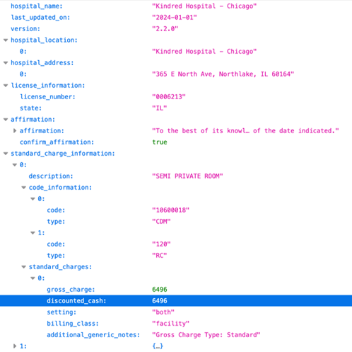
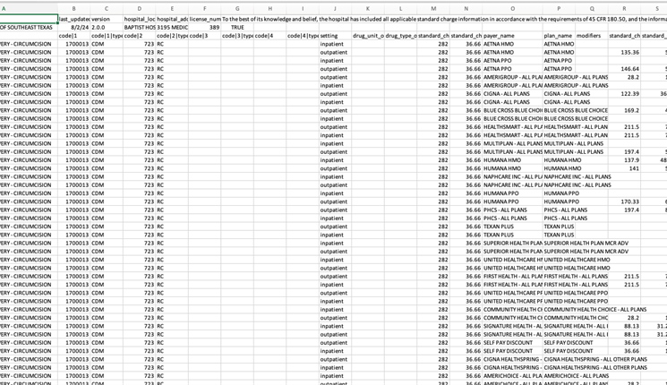
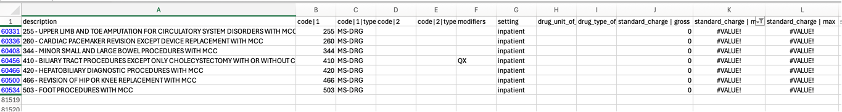
UNSTRUCTURED DATA
Json data format
Excel data format with null values
Notes:
Here's a snapshot of the unstructured data

Slide 11

DATA CLEANING | AUTOMATION
CHALLENGES
SOLUTIONS
Broke down datasets to individual issues
Power Query & Python to normalize datasets
Inconsistencies in Pricing Data
File & Entries format, Column Names,
Automation Scripts Complexity
LEARNINGS
Tackling complexity requires breaking problems into actionable pieces and using the right tools, deliver impactful results.
Notes:
Cleaning and automating data is a crucial step in any project. It ensures consistency, accuracy, and efficiency in processing large datasets, enabling meaningful insights.
Our datasets had varying formats like JSON, XLSX, CSV, and different column names, and entry structures. This made it challenging to combine or analyze the data effectively.
The complexity of automating these processes, especially for inconsistent data formats, required significant effort and iterations to develop robust scripts.
We tackled the problem by breaking down the datasets into smaller, manageable issues. This allowed us to address inconsistencies step by step.
We utilized tools like Power Query and Python to standardize and normalize the data. These tools significantly reduced manual effort and streamlined the cleaning process.
We realized that tackling complexity requires breaking problems into actionable pieces and leveraging the right tools. This approach not only simplifies the process but also delivers impactful results.
These efforts in data cleaning and automation laid the groundwork for accurate analysis and reliable integration into the larger system.

Slide 12
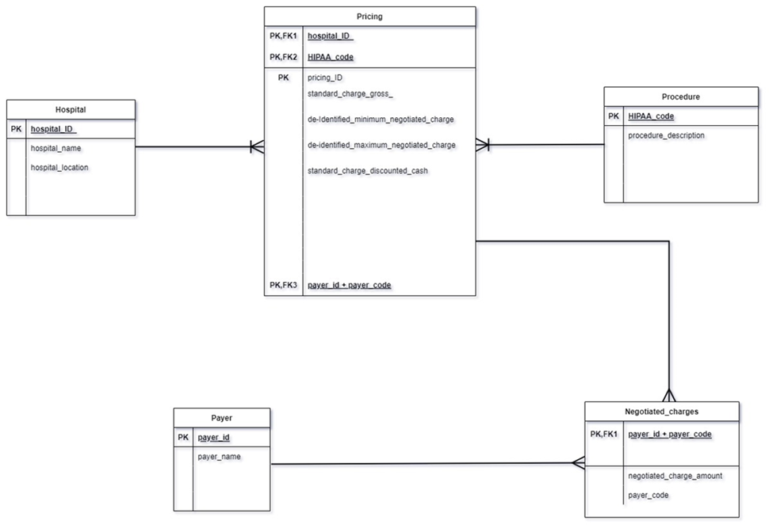
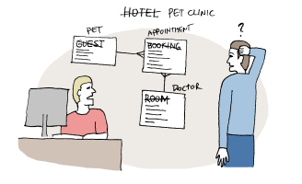
DATABASE DESIGN
Preliminary ERD: A Starting Point for Database Structure
Opportunities for Improvement :​
Ambiguous Relationships
Redundant Data
Scalability Issues
Initial Version of ERD

Slide 13
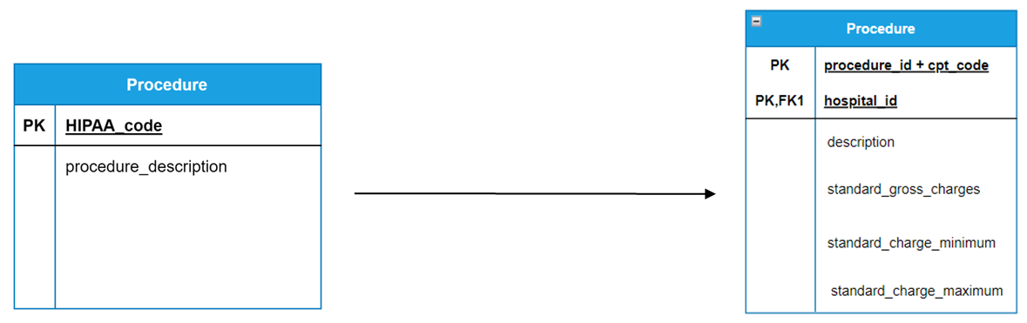
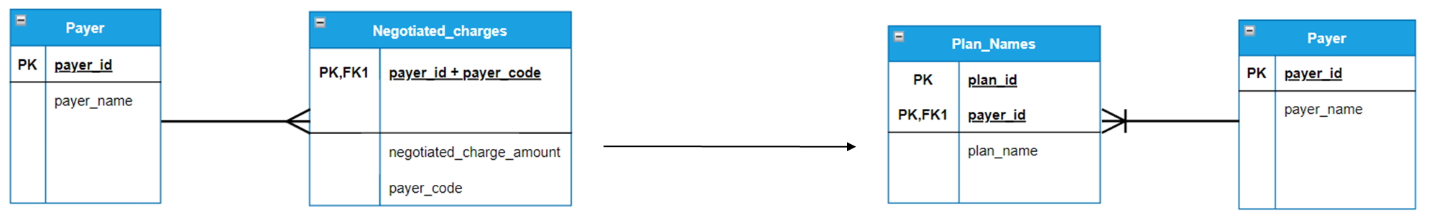
A JOURNEY IN REFINING DATABASE DESIGN
Introduced procedure_id and cpt code as a composite primary key
AMBIGOUS RELATIONSHIP
UNAMBIGOUS RELATIONSHIP
Separate Table for
Plan names
UNREFINED TABLES
REFINED TABLES

Slide 14
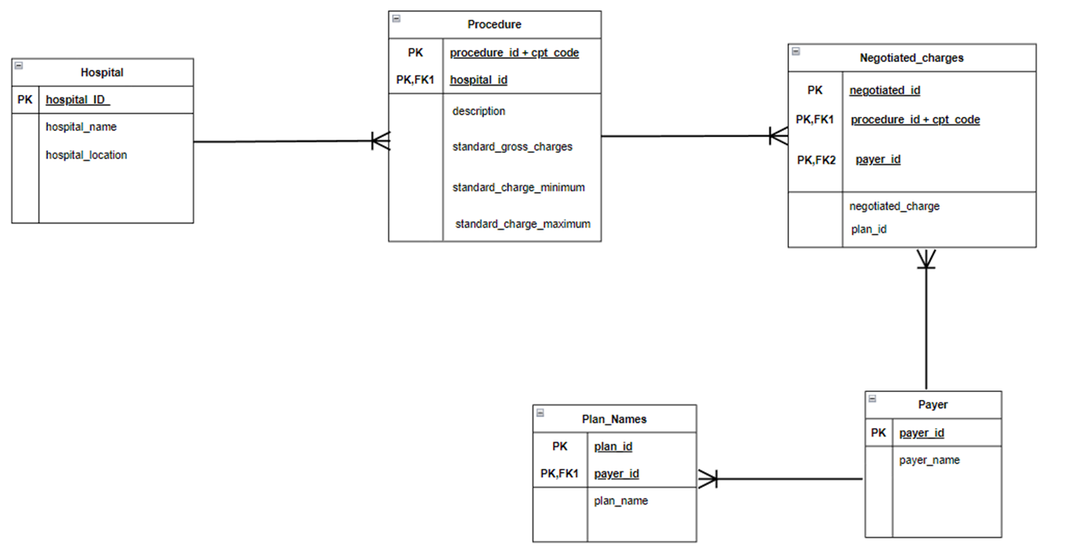

DATABASE DESIGN - SOLUTION
Normalized Structure
Composite Keys
Clear Relationships
Granular Design
Modular Organization
Final Version of ERD

Slide 15



LESSONS LEARNT
Embracing Iterative Refinement
Importance of Feedback
The Final ERD is more scalable, normalized, and modular,
ensuring a better database structure for future growth and maintenance.

Slide 16
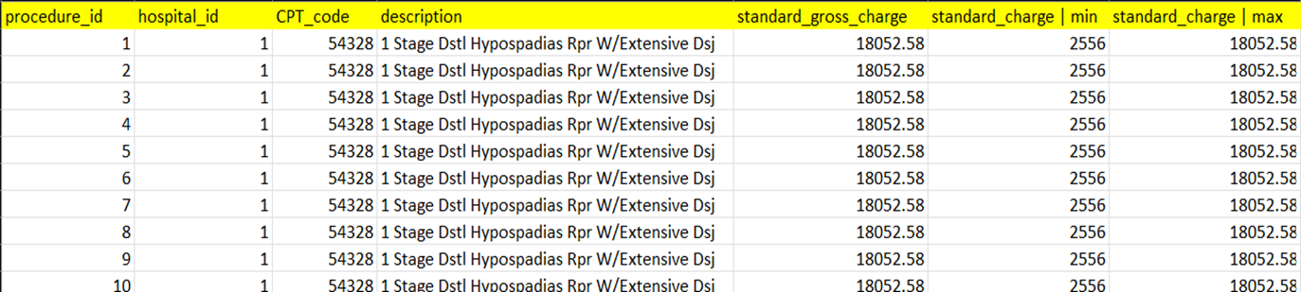
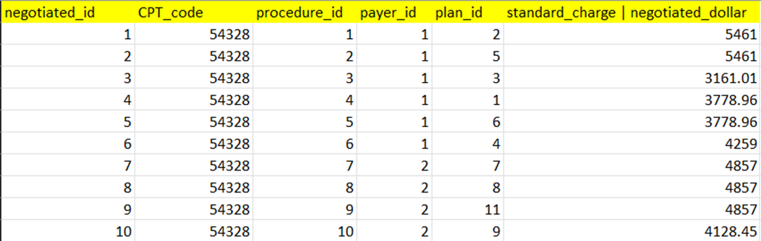
DATA LOADING
Procedure Table
procedure_id -> Primary Key of Procedure Table
hospital_id -> Foreign Key referencing to Hospital Table
Negotiated Table
negotiated_id -> Primary Key of Negotiated Table
CPT_code and procedure_id -> Composite Primary Key
payer_id and plan_id-> Foreign keys referencing the Payer and Plan tables, respectively.

Slide 17
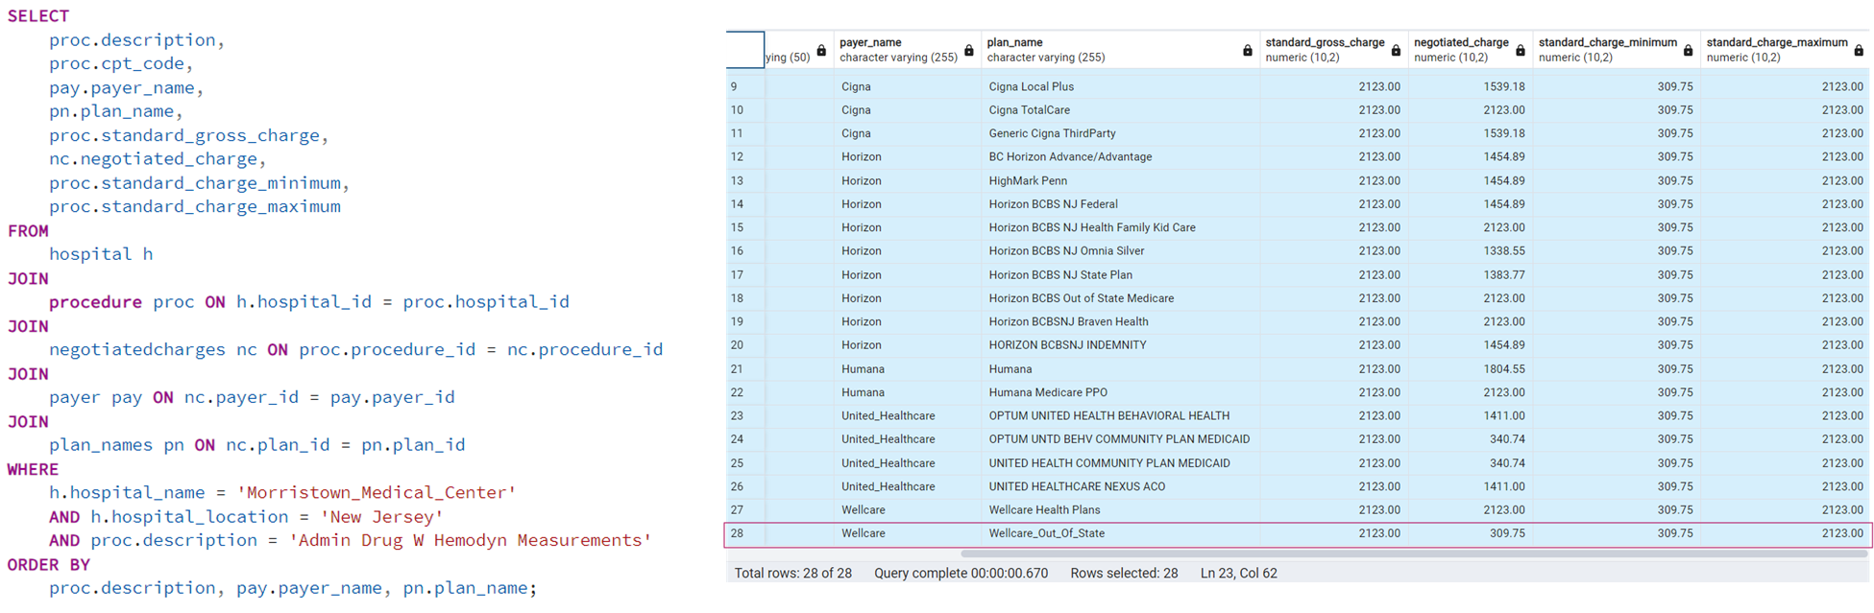
OPTIMIZED SOLUTION

Slide 18
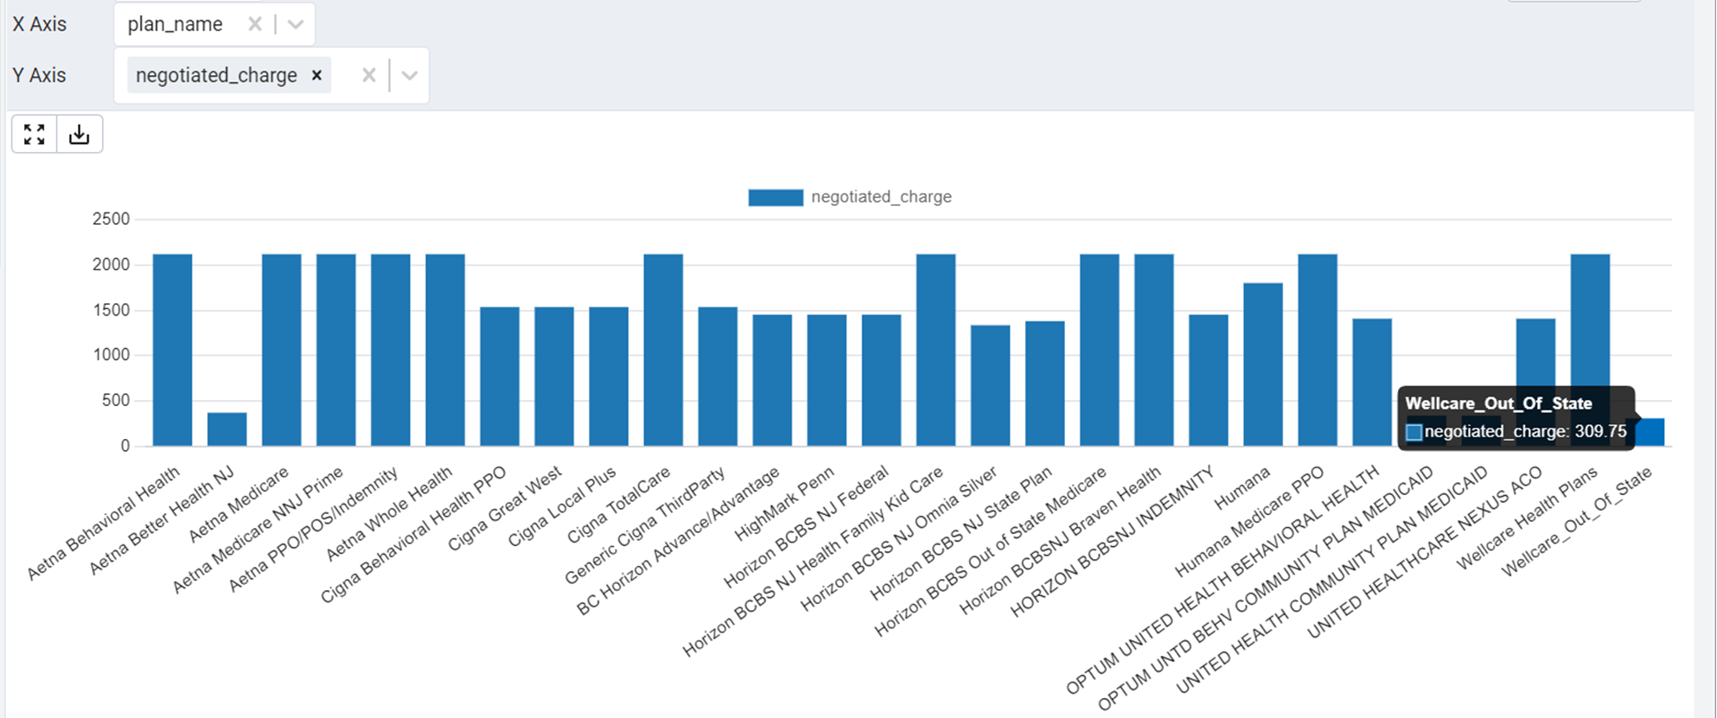
VISUALIZATION

Slide 19

WHY DOCKER?
Key Benefits of Docker :
Portability: Run anywhere.
Resource-efficient: Lightweight.
Scalable: Easily scale services.
Isolation: Prevents conflicts.
Faster CI/CD: Integrates with DevOps pipelines.

Slide 20
DOCKER INTEGRATION
CHALLENGES
SOLUTIONS
Cloud-based storage
Standardized naming conventions.
Dynamic port allocation, centralized config
Prometheus, Grafana integration
Container orchestration, scaling, load balancing, high availability, fault tolerance
Data Volume Management
Container Naming Conflict
Port Mapping Challenge
Performance Monitoring
Use of Docker Swarm
LEARNINGS
Seamless integration demands proactive planning

Slide 21
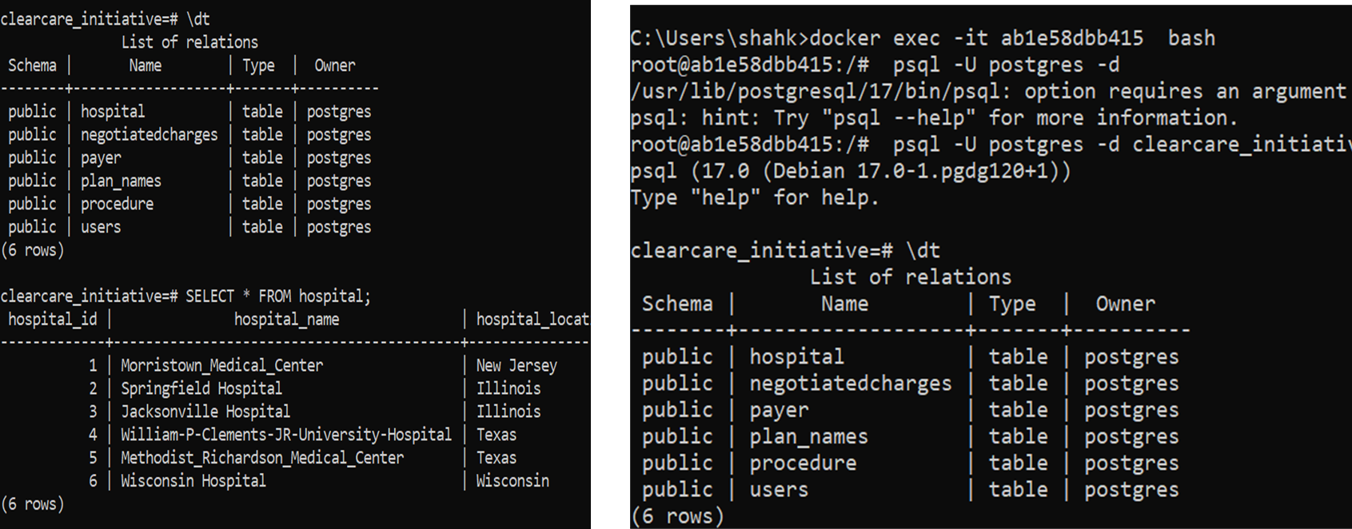
DOCKER OUTPUT
Final Datasets with all Hospital Lists

Slide 22
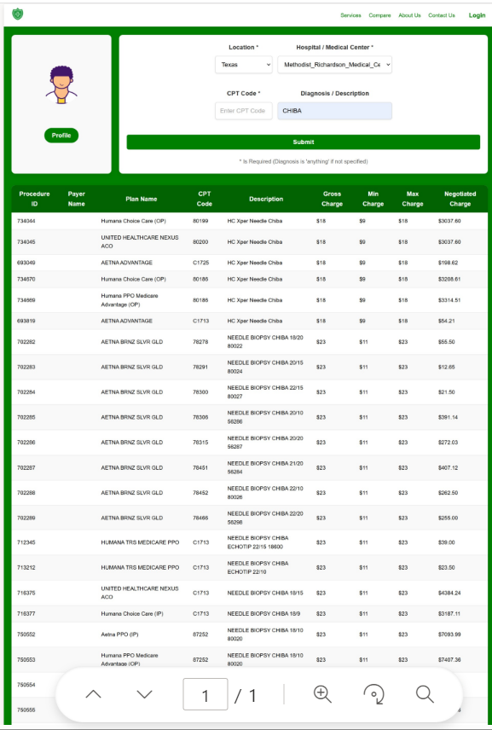
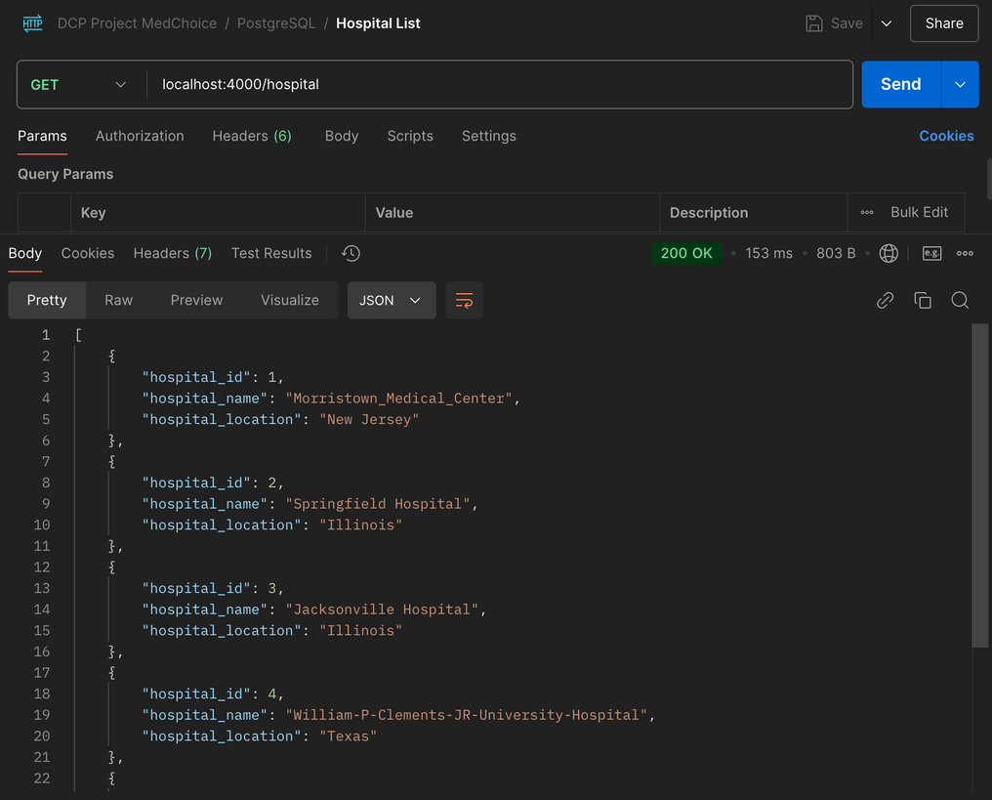
FINAL INTEGRATION

Slide 23
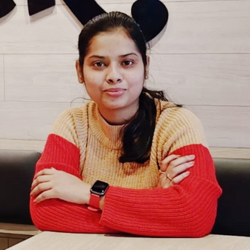


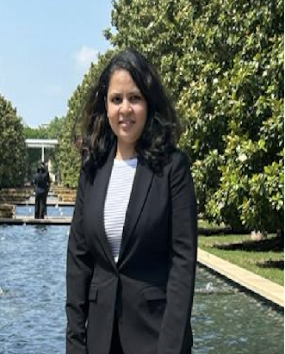
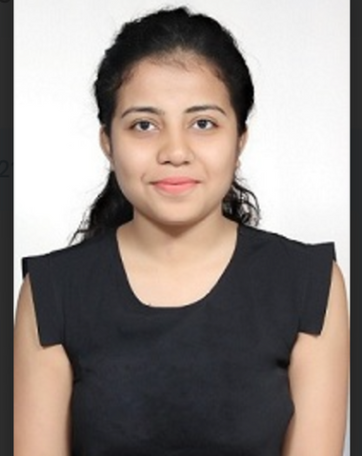

PEOPLE
NITHISH YERRAM
UTKARSHA C.
SAI THUSHARA C.
RESEARCH, AUTOMATION
DATABASE ADMIN
AUTOMATION
KRATI SHAH
SVAYAM PRABHA
PRANAV NAYAK
DOCKER
AUTOMATION
DATA COLLECTION

Slide 24
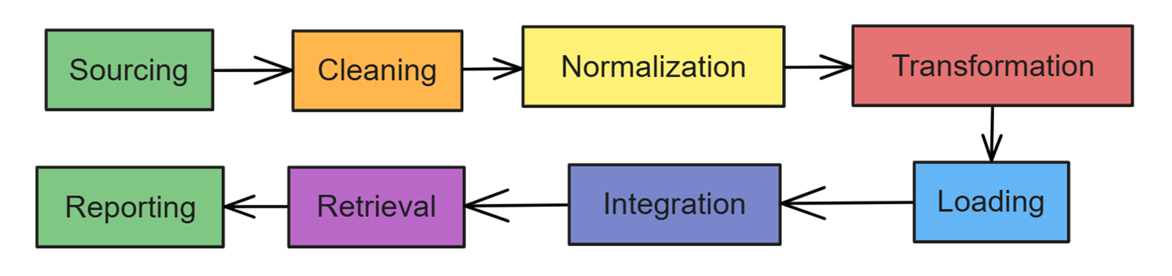
PROCESS
Iterative improvement of workflows and regular feedback
from stakeholders (Client, Professor, UI Team).

Slide 25





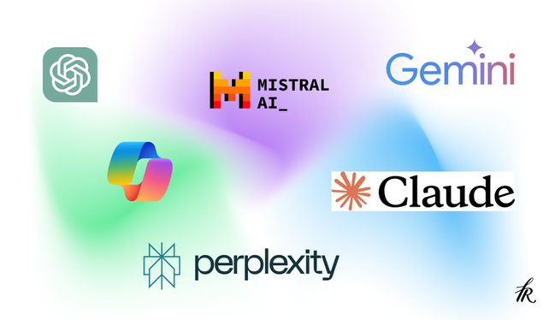

TOOLS & TECHNOLOGIES

Slide 26


SETBACKS
Inconsistent documentation (Schema) during SQL and API integration stages led to some rework.
Setbacks are just setups for stronger comebacks.
Missed opportunities for feedback early in the automation process and Coordination between Data and UI Team.
Notes:
"As we started building our schema, we based it on the datasets we gathered from hospital websites and focused on preprocessing and cleaning the data. Meanwhile, Team 5 needed a starting point for their API development. Since the data was extensive and noisy, we were still refining our schema when Team 5 drafted theirs based on the requirements communicated to them.
However, a misalignment arose between the schemas. Their design included tables like hospitals, insurance, providers, and plans, while ours had a different structure, featuring negotiated charges, payers, procedures, and plan names. This mismatch resulted in rework for both teams,
Later that we came together to resolve Docker issues, API integration challenges, and other technical hurdles. Despite these delays, we successfully aligned our efforts and moved forward smoothly."

Slide 27

CONCLUSION
Complex healthcare problem
Challenges & technical hurdles
Collaboration
Scalability & Efficiency

Slide 28
THANK YOU

